Slide 1


CST3310 – Strategic Information Systems (Enterprise Project) Management
Case Study: BT Group
Group CST3310HE08
Student Number​ | Student Name​
M00944298​ | Parmdeep Gill​
M00810926​ | Abdullahi Mohamed​
M00958490​ | Boluwaji Kehinde​
M00811809​ | Shoyful Islam​
M00974403​ | Chinonso Nwafor​
M00853031​ | Ali Hassan​
M00844801​ | Manitta Sunny Eappen​

Slide 2
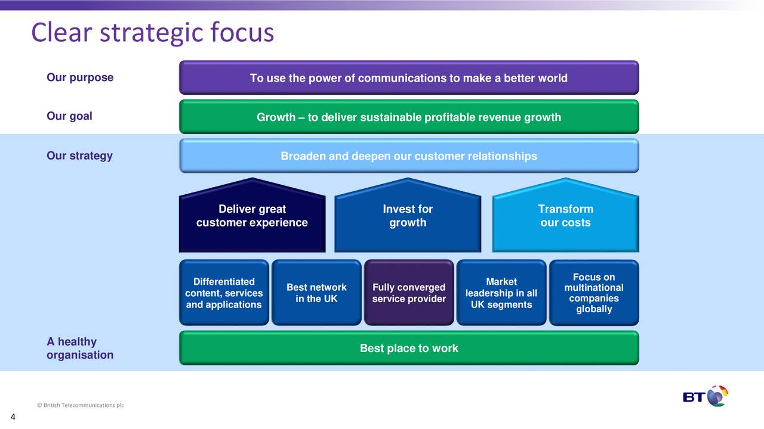
Case Study: BT Group
Telecommunication company based in in the London, England.
Company values is personal, simple and brilliant
Largest provider of fixed-line, broadband and mobile services
in the UK
​

Slide 3
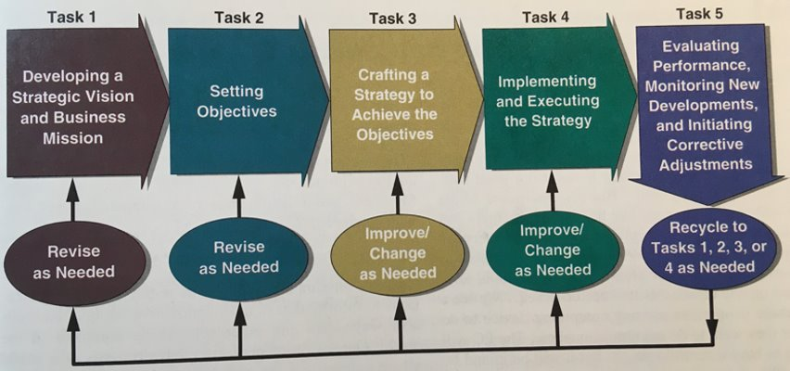
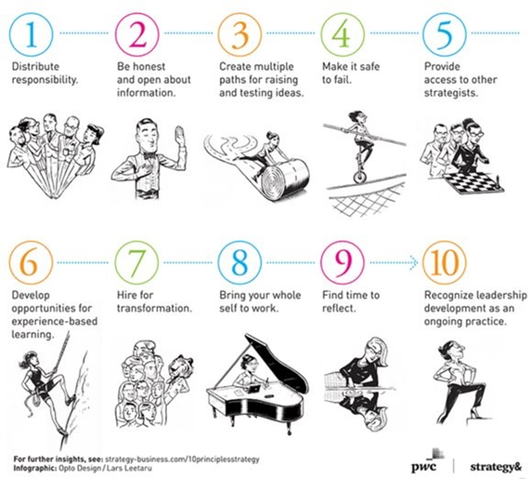
Topic 1: Strategic Management Principles
BT Group strategic management process
BT vision and mission statements.
Become the world most trusted connector
Evolving principles and aligns with company resources
BT competitor analysis
Porter’s Five forces
A blend of other methods such as PESTLE, SWOT
Technological trends and economic factors e.g. budget
BT Leadership approach
Sub-contracting, delegate tasks
Company values personal, brilliant and friendly
A bright sustainable future and add value to stakeholders

Slide 4
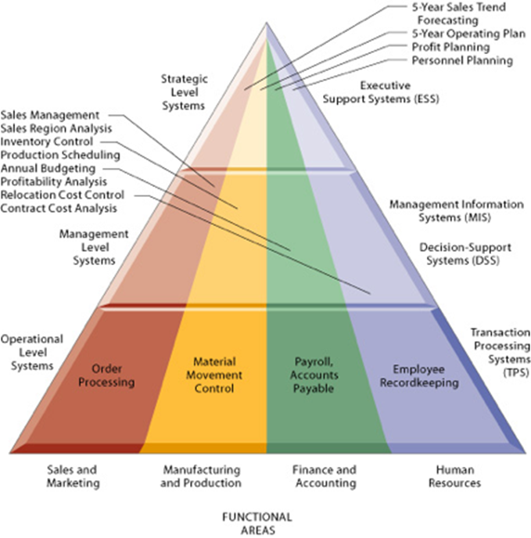
Topic 2 : Information system types
•Types of Information systems used in BT
•Suitable typology for classifying BT’s systems
•Core functions of Information systems in BT

Slide 5
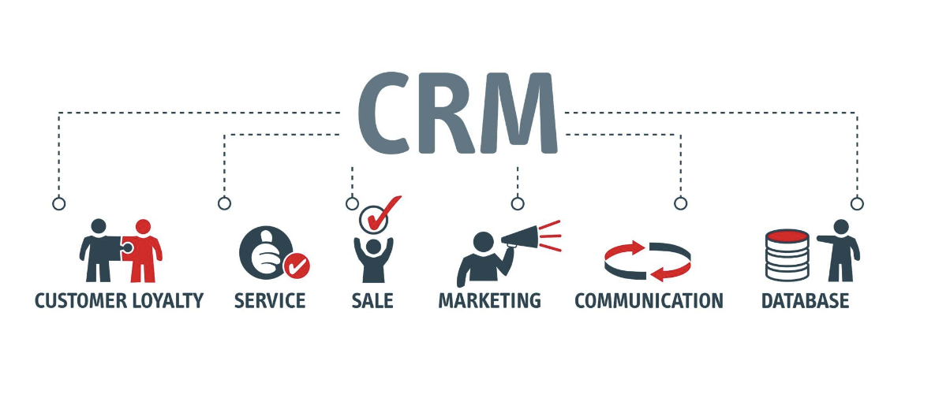
Topic 2 : Information system types
•BT Updated CRM strategy
Transition from Monolithic approach to a more modularized architecture
•BT’s Information System Architecture
BT has a vast estate of over 200 applications that make up the core of the
•Information systems used by BT across IT applications and Network functions
Business support systems for IT Apps
Operational support systems for Network Functions

Slide 6
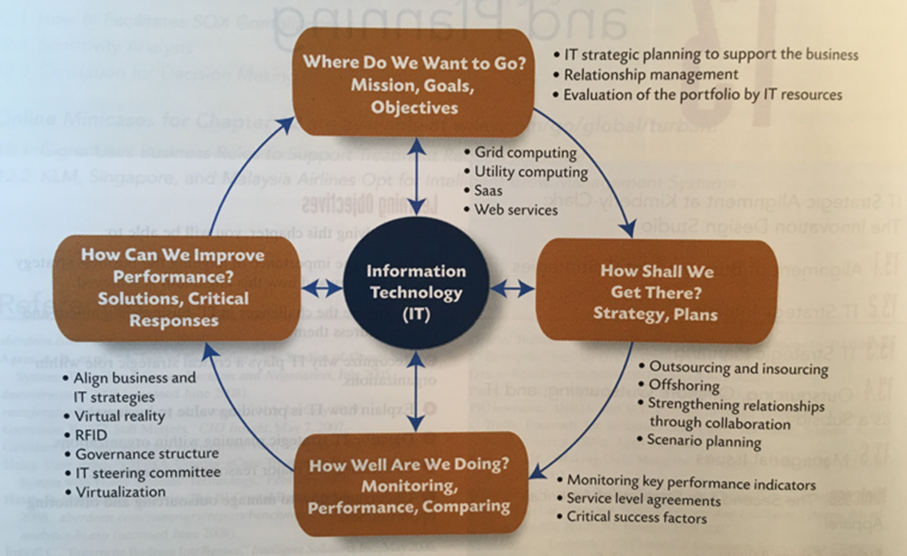
Topic 3: Managing IT Projects
The first point of this topic is how IT projects are managed in BT:
BT follow project management methodologies, depending on criteria of the project. They mainly implement Agile, Waterfall method based on the requirements of the IT project.
The next point is the core IT project management practices that BT follow.
For BT, time management, meeting deadlines are practicing that BT adhere too. These practices are important for BT as they have customer/subscribers. Missing deadlines for projects targeted towards their customers could cause them to lose their existing base to rival competitors. Therefore, these management practices are crucial for BT

Slide 7
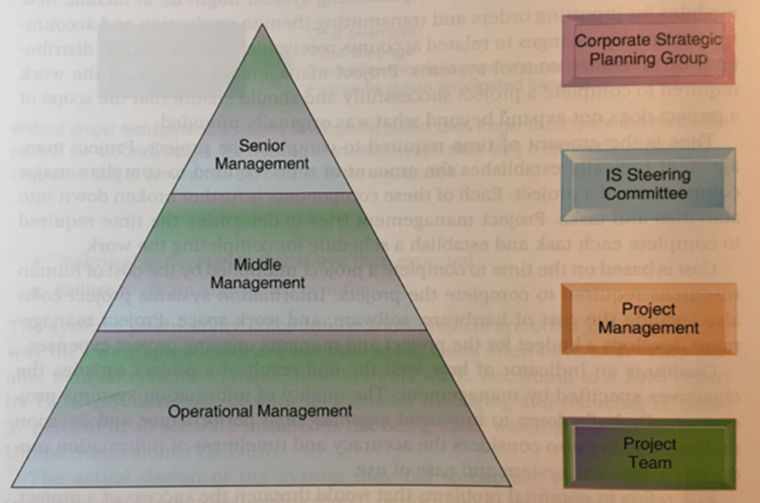
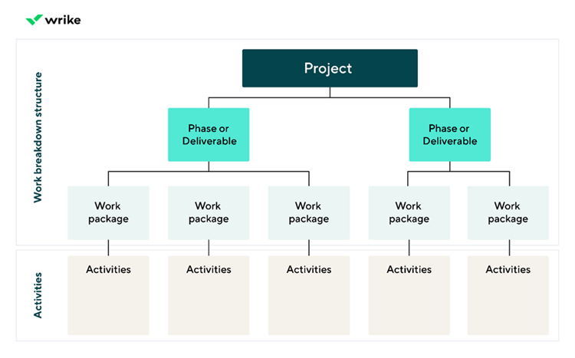
Topic 3: Managing IT Projects
A project management plan for BT
Comprehensive Framework
Introduction of BT Goals
Address key Elements
Key work packages for BT
Breaks down large tasks into smaller activities
System Design Example
Efficiency and time management

Slide 8
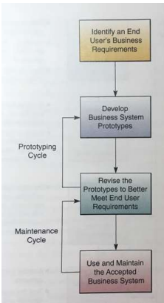
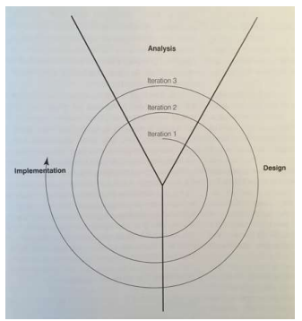
Topic 4: System Development Models
Reviewing Appropriate Models for BT Group
Identify suitable Models
Why they are suitable
Best Model for BT group
Evaluating the most appropriate model
Comparison of various models
Implementing the appropriate Model in
BT Group
Implementation Process
Implementation Challenges BT Group might
Face and possible solutions.

Slide 9
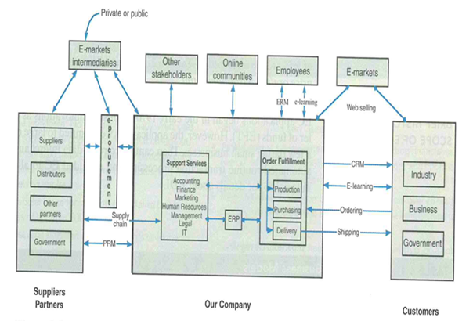
Topic 5: Digital Business Models
Overview of appropriate digital models for the specific sector
Subscription Models
Data monetisation model
Description of an appropriate model that is in place at the organisation
BT commonly use a subscription model
BT customers are put on a fixed contract with a recurring fee
Reflection on how the model is implemented and its impact on the organisation
Subscription model allows BT to predict their revenue streams
BT will retain customers with this model as they can provide them with reasonable prices catering towards the customer

Slide 10
Questions

